Slide 1


Miner League
Data Science for Talent Management for DDSAnalytics

Slide 2

DDSANALYTICS
DDSAnalytics is an analytics company that specializes in Talent Management solutions for Fortune 1000 companies.
DDS Analytics focus on iterative process for developing and retaining employees by using various HR techniques.
Techniques include workforce planning, employee training programs, identifying high-potential employees and reducing/preventing voluntary employee turnover (attrition).
Objective : Our Firm Miner League which specializes in leveraging data science for Talent Management has been hired by DDS Analytics to predict various contributing factors that lead to turnover and attrition. As part of this analysis we will also provide specific trends related to job roles and other trends and observations in the industry.

Slide 3
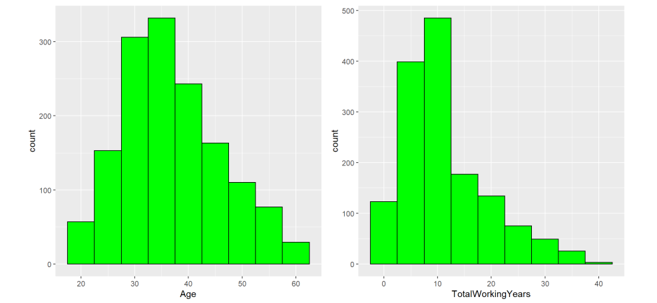
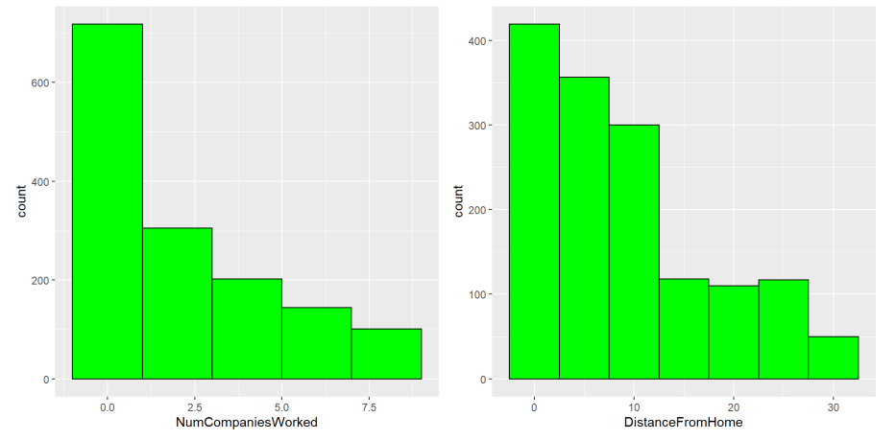
Employee Demographics - Basic
Observations :
Average Age of employees is around 37 years and only 22% of the employees are under the age of 30.
Average Years of experience is around 11 years with 49% of the employees with less than 10 years of experience.
Most employees have worked in more than 1 companies with an average of around 2.7.
As far as distance from home, most live relatively close as within 10 miles from the office.

Slide 4
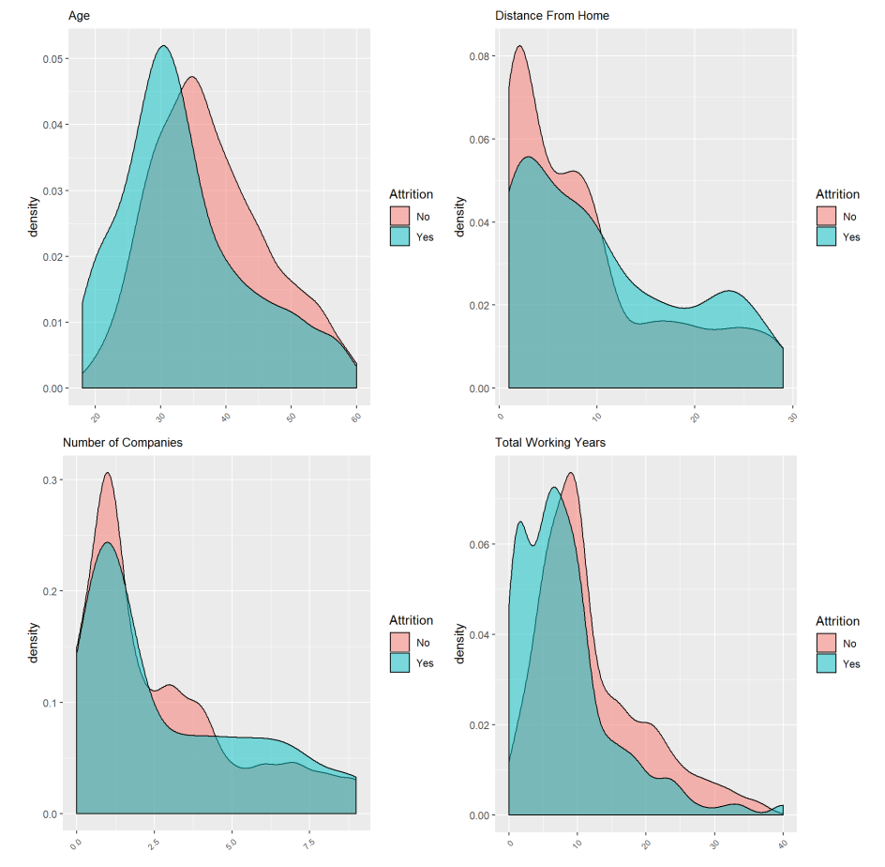
Employee Demographics – Basic vs Attrition
Observations:
Younger employees between 25-35 years have a higher attrition rate.
There is a higher attrition rate when the distance from home is greater than 10.
Attrition rate is less below 10.
Attrition rate seems to be higher for employees who have work with 5 to 7 companies.
The highest attrition rates seem to be with employees with between 0 to 7 years of work experience.

Slide 5
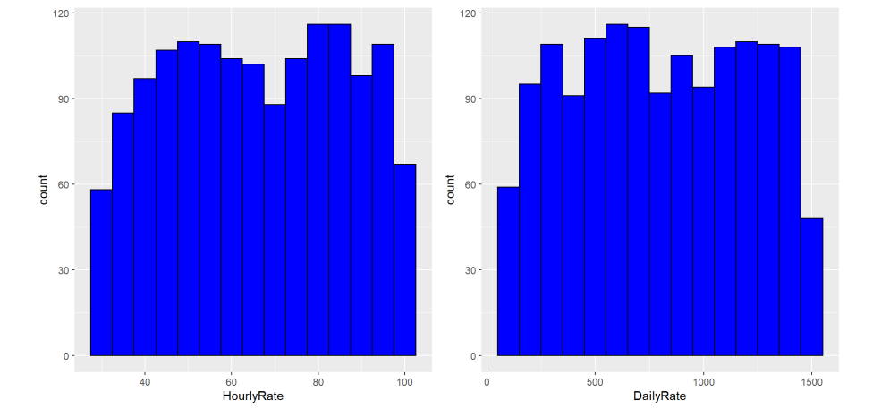
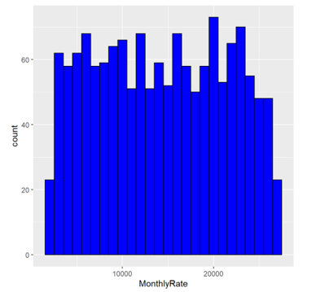
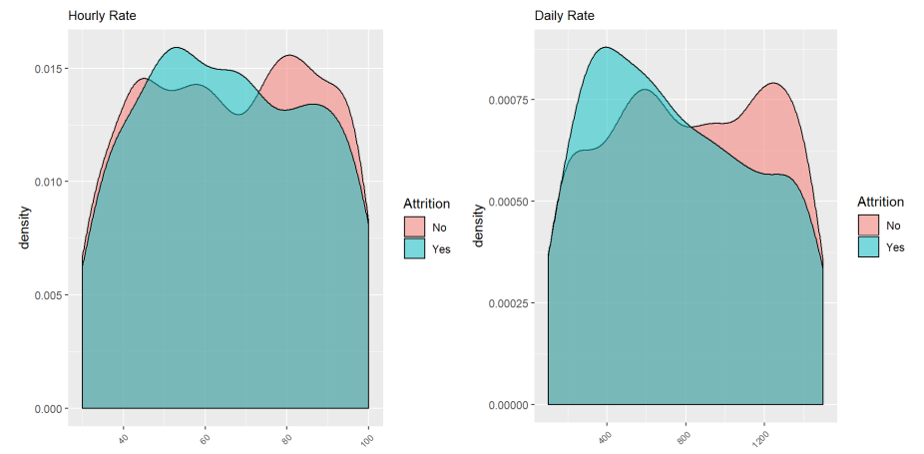
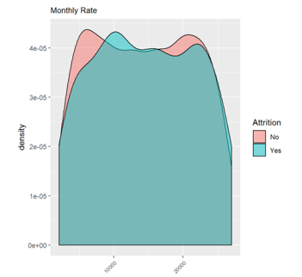
Employee Demographics - Financial
Observations:
No patterns are observed in this data.

Slide 6
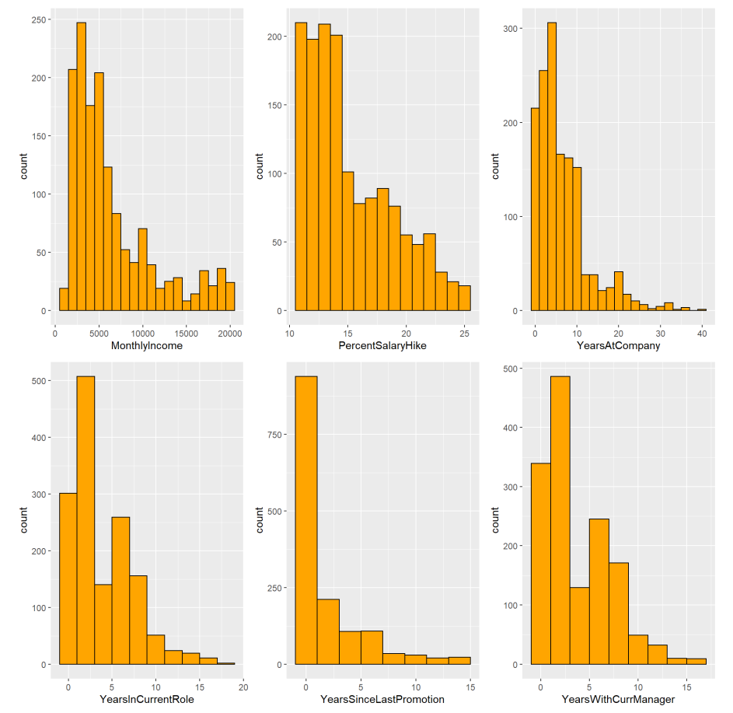
Employee Demographics - Work Environment
Observations:
Average monthly income is around 6.5k and majority of the employees make less than 6.5k.
Average employees has been with the company for about 7 years however majority of the employees are relatively new and have not been around for long.
Average employee at a role is around 4 years and then they either leave or move on to something else.
Promotions are frequent it seems, employees are getting promoted on average every 2 years.

Slide 7
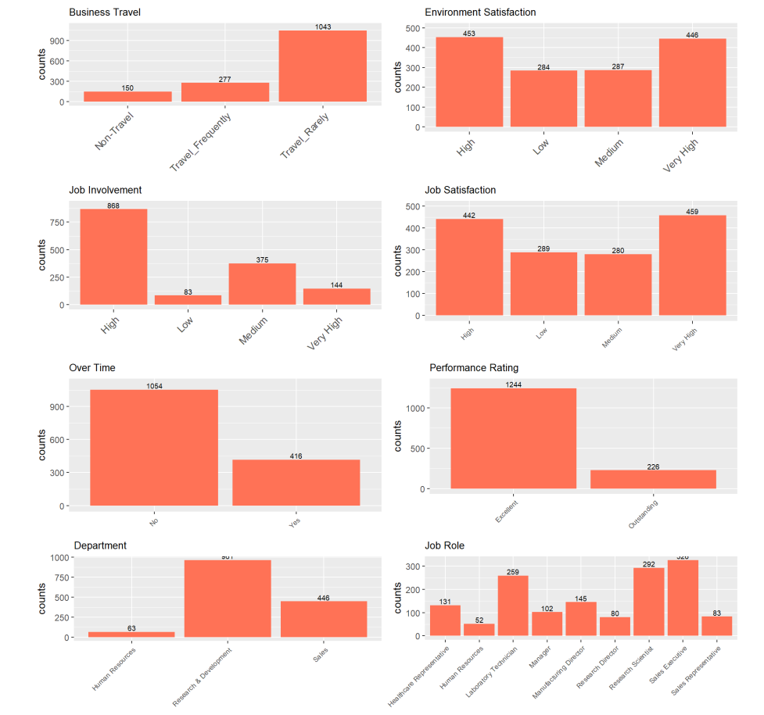
Employee Demographics - Work Environment(Continued)
Observations:
Approximately 71% of the employees rarely travel for work.
Approximately 30% of the employees rate environment satisfaction as high or very high.
Approximately 59% of the employees rated their job involvement at work as high.
Approximately 30% of the employees rate job satisfaction as high or very high.
Approximately 72% of the employees do not work overtime.
Approximately 85% of the employees have an Excellent Performance Rating.
More than half 65% of the employees work in Research & Development.
Most employees work as Sales Executives, Research Scientists or Laboratory Technicians
2
1
1
2
4
3
3
4
5
5
6
6
7
8
7
8

Slide 8
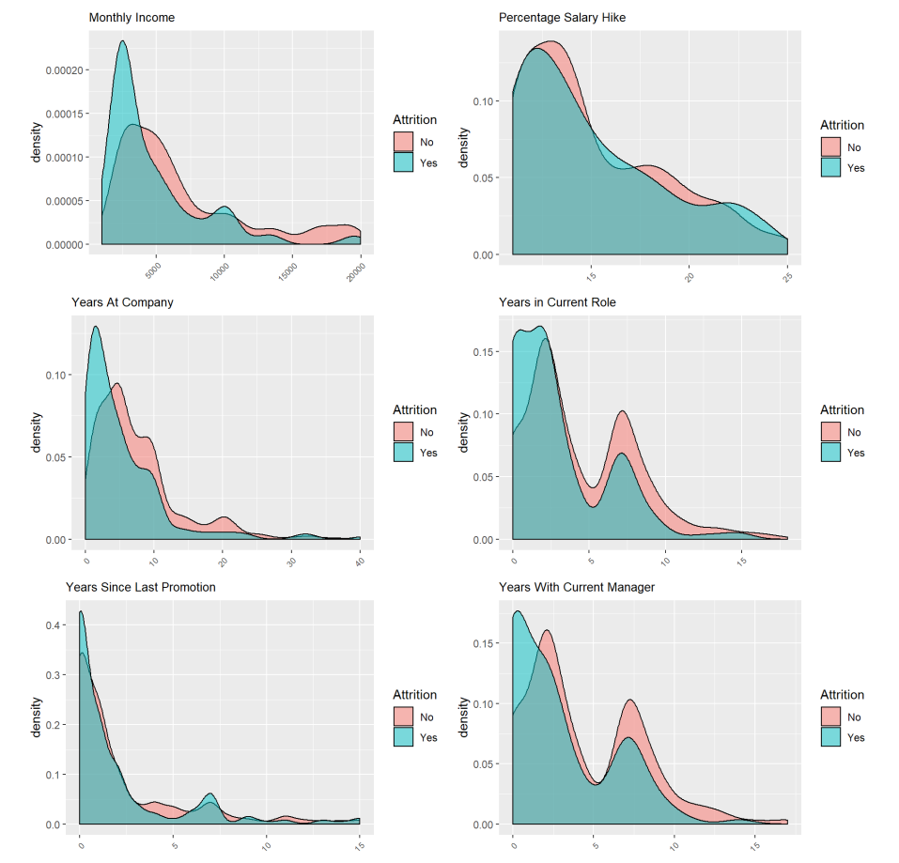
Employee Demographics - Work Environment vs Attrition
1
Observations:
Peak attrition occurs when the monthly income rate is about $2500.
Peak attrition rate also occurs when the employee is with the company for approximately 0-2 years.
Attrition rate is higher when the employee is in the same role for 0-2 years or 6 years approximately, based off of the bi-modal nature of the graph.
Attrition rate is higher when the employee is with the same manager for less than 1.5 years or 6 years approximately, based off of the bi-modal nature of the graph.
1
2
2
3
3
4
4

Slide 9
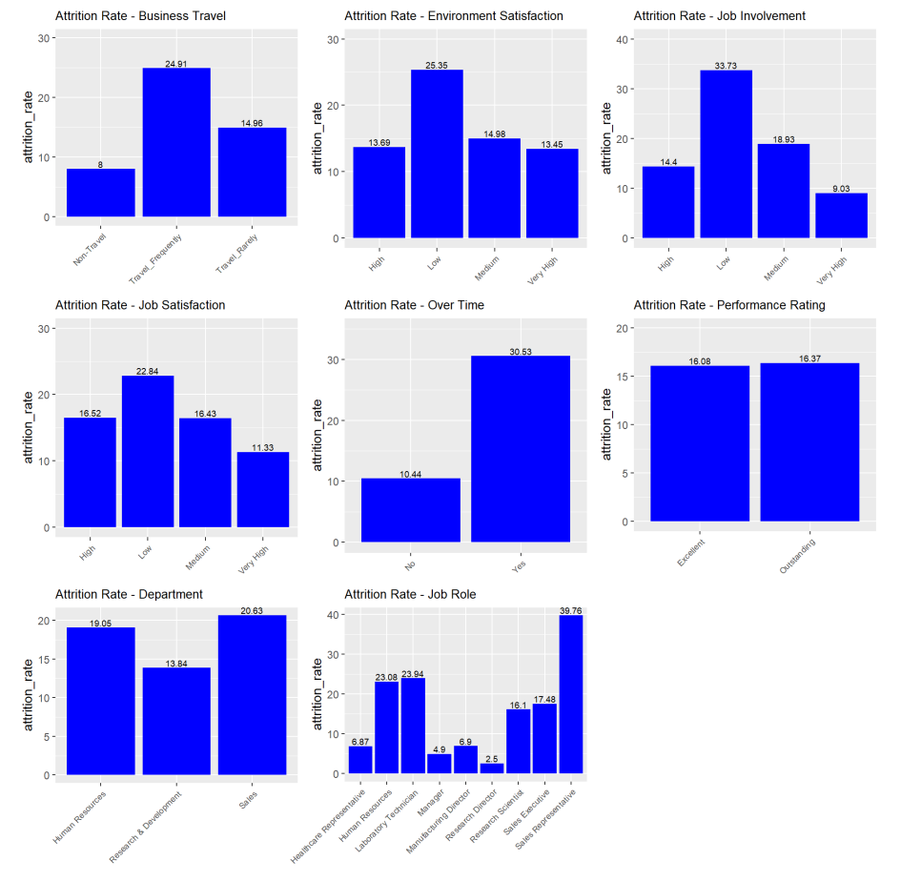
Employee Demographics - Work Environment vs Attrition (Continued)
Observations:
Employees who travel frequently have a higher attrition rate.
Employees who score environmental satisfaction, job involvement and job satisfaction low have higher attrition.
Employees who work overtime have a higher attrition rate (approximately 30%).
Employees in the Sales Department have the highest attrition rate at 20%.
Employees who are Sales Representatives have the highest attrition rate at 40%.
1
1
2
2
2
3
4
2
3
5
4
5

Slide 10
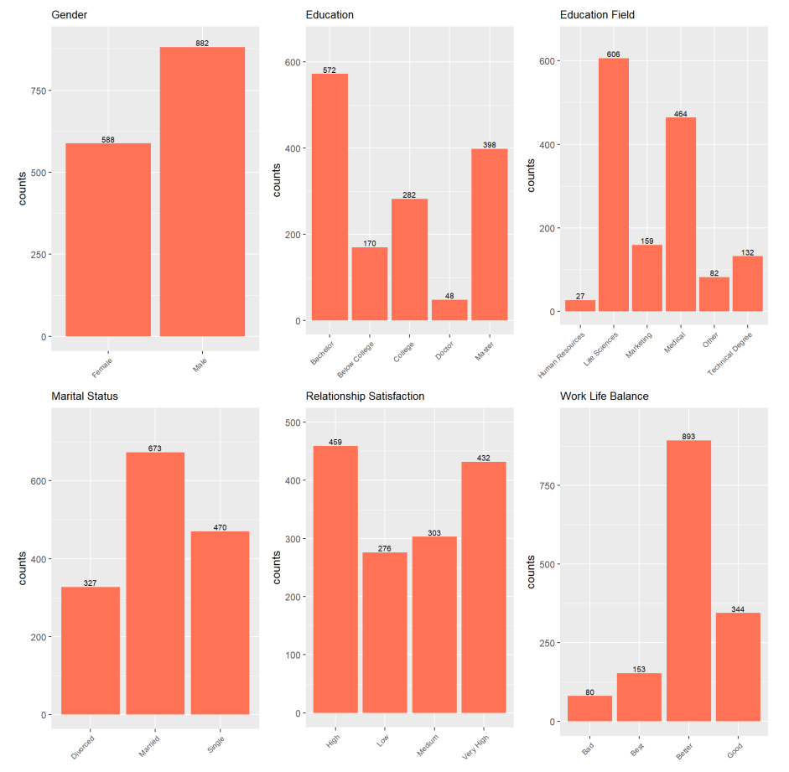
Employee Demographics - Personal
Observations:
Approximately 60% of the employees are male.
Approximately 39% of the employees have a bachelors degree, with 27% having a masters degree.
Approximately 76% of the employees have a life science or medical degree.
Approximately 46% of the employees are married, with 32% being single.
More than 30% of the employees rate Relationship Satisfaction as High or Very High.
More than 60% of the employees rate Work Life Balance as Better.
2
3
1
1
2
3
4
5
4
5
6
6

Slide 11
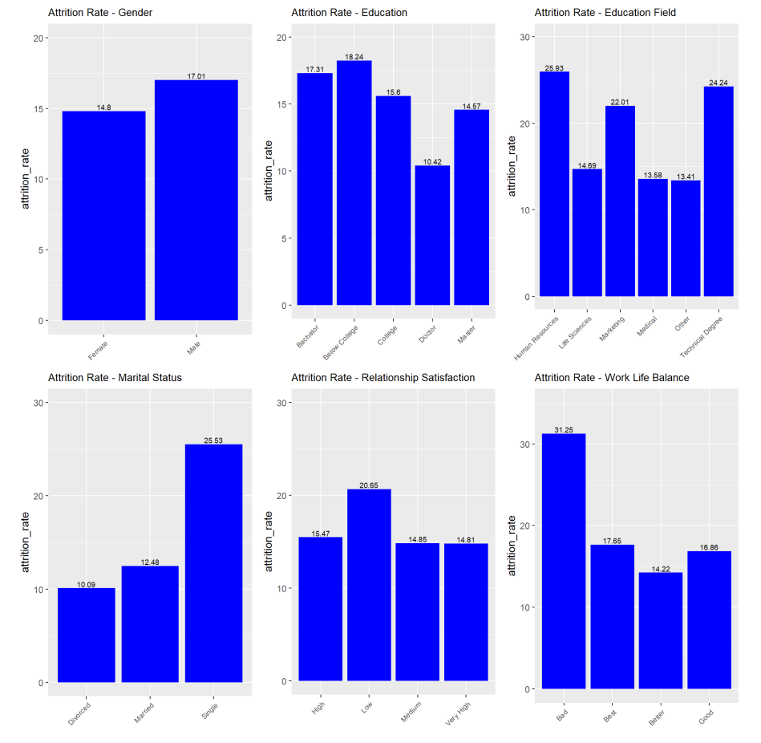
Employee Demographics – Personal vs Attrition
3
Observations:
Male attrition rate is higher than female attrition rate.
Attrition rate is approximately 18% for employees with no college education.
Attrition rate is highest for those employees with backgrounds in HR, Marketing or a Technical Degree.
Attrition rate is highest for single employees.
Attrition rate is highest for employees with low relationship satisfaction.
Attrition rate is highest for employees with bad work life balance.
1
1
2
2
3
4
5
4
5
6
6

Slide 12
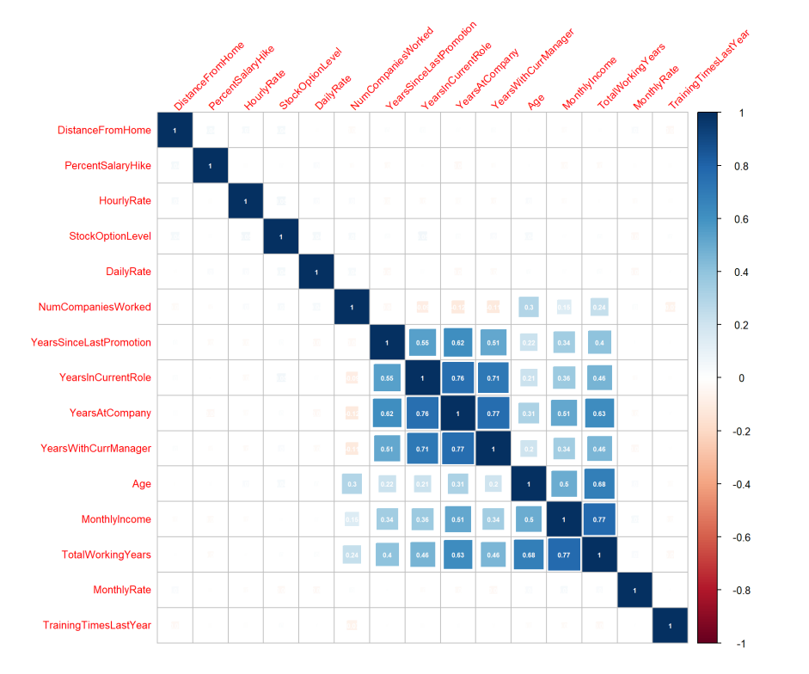
Correlation
Highly Correlated Observations:
YearsInCurrentRole and YearsAtCompany (0.76)
YearsInCurrentRole and YearsWithCurrManager (0.71)
YearsAtCompany and YearsInCurrentRole (0.76)
YearsAtCompany and YearsWithCurrManager (0.77)
YearsAtCompany and TotalWorkingYears (0.63)
MonthyIncome and TotalWorkingYears (0.77)

Slide 13
Conclusion
From our analysis here at Miner League we can see that the following variables, broken down by type may have an influence on attrition:
Department
Job Role
Level of Education
Amount of Travel
Amount of Overtime
Employees with low satisfaction scores in Job Satisfaction,
Job Engagement and Environmental conditions may also need to be taken into account
Years In Current Role
Years At Company
Years with Current Manager
Total Working Years
Monthly Income
Categorical
Non-Categorical

